Slide 1
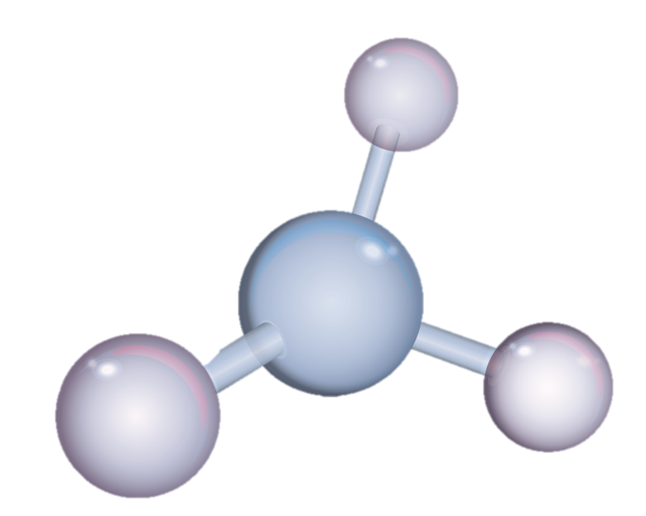
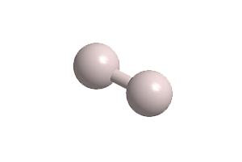
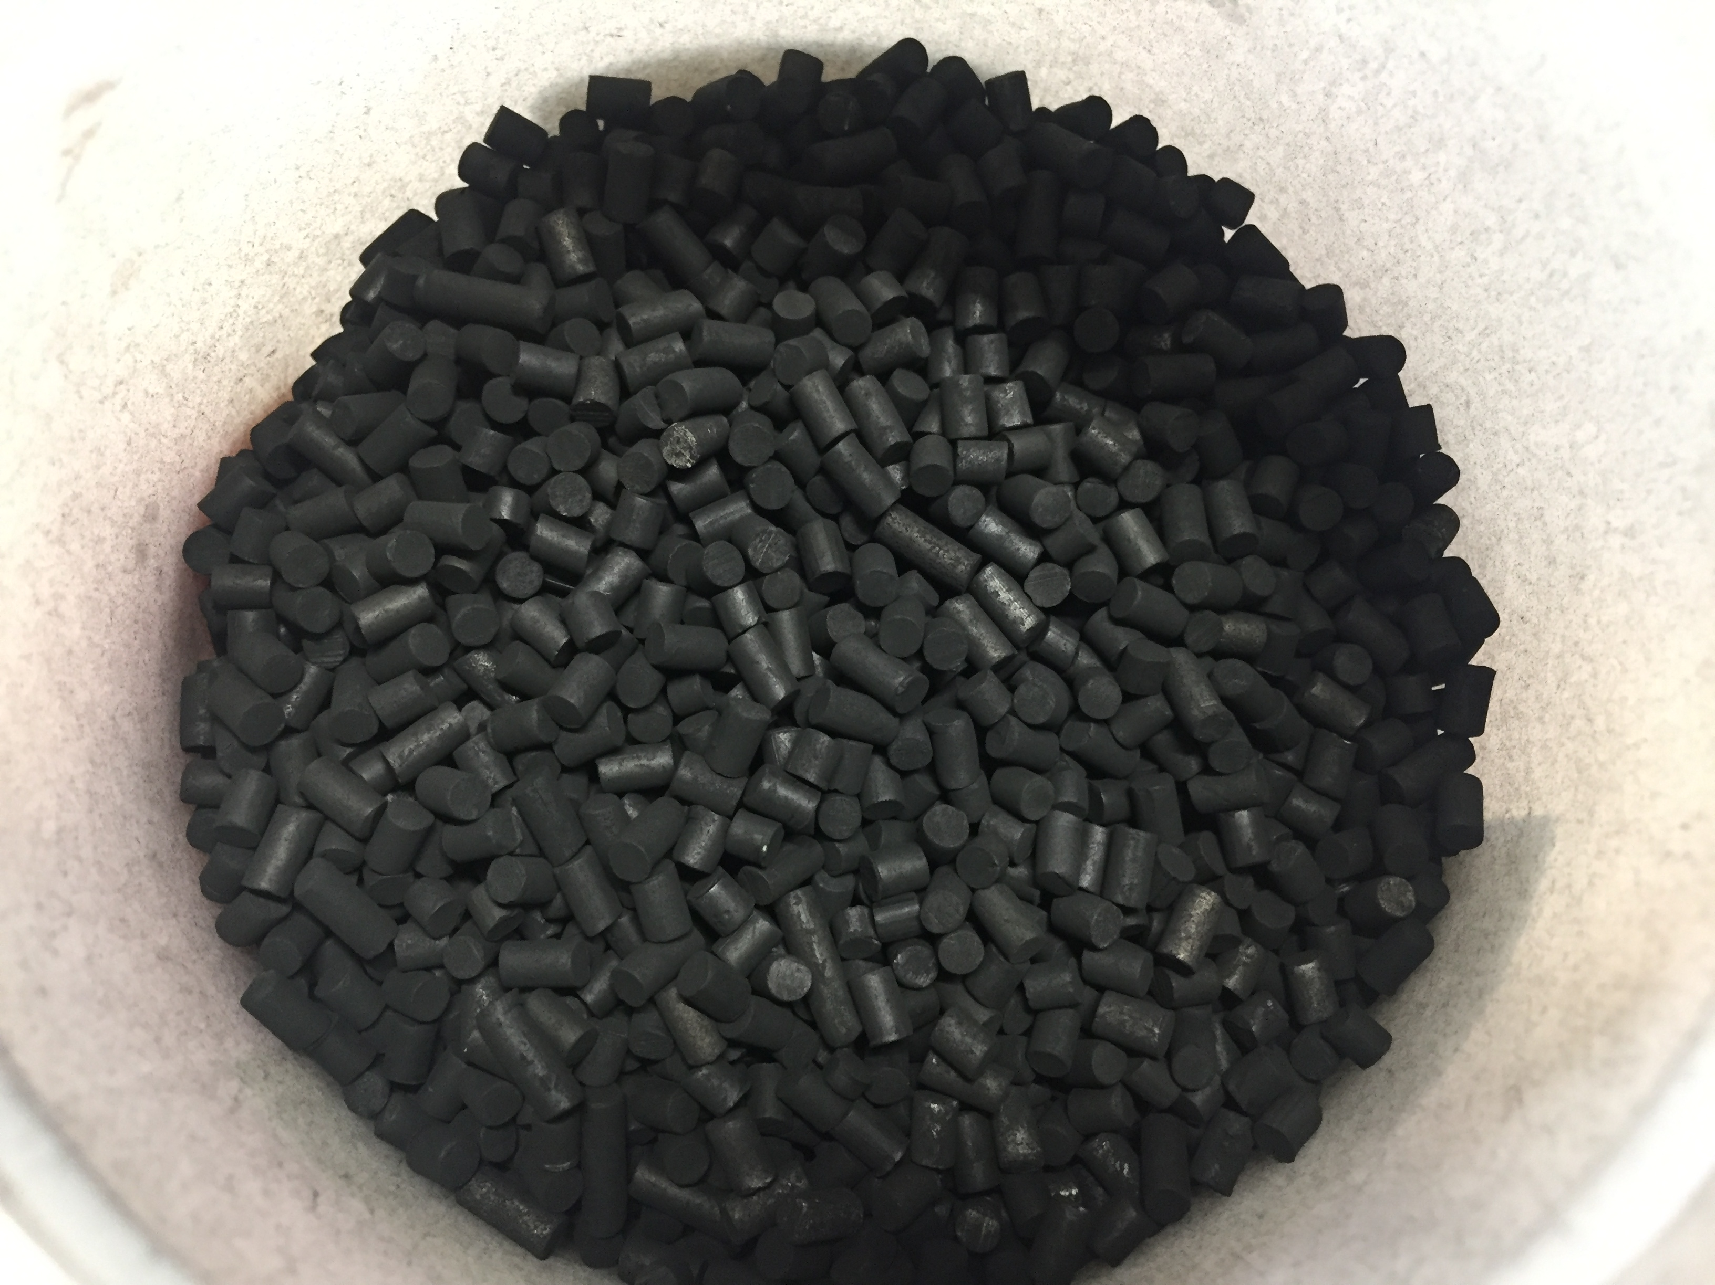
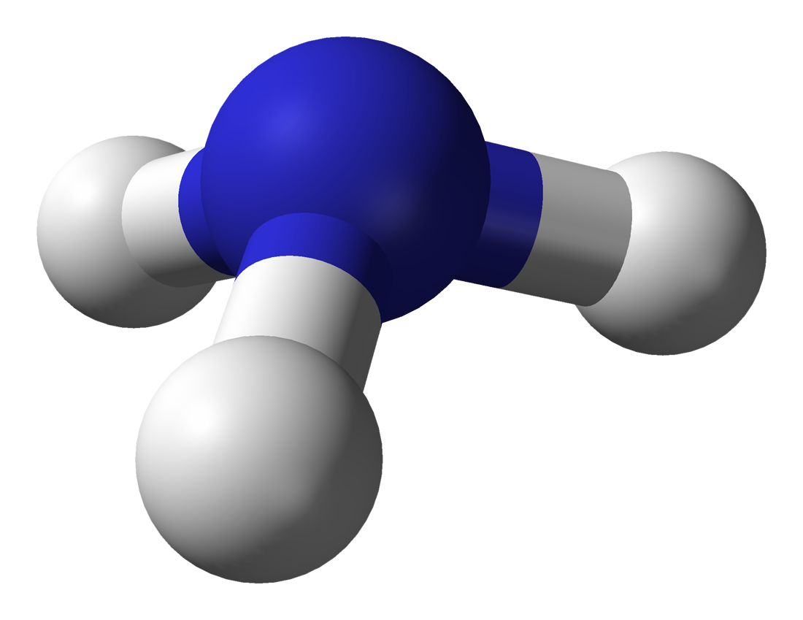



Techno-economic assessment of a decentralized system for pure hydrogen production via green ammonia decomposition
H₂
Dr. Valentina Cechetto
Prof. Dr. Eng. Fausto Gallucci
NH₃

Slide 2


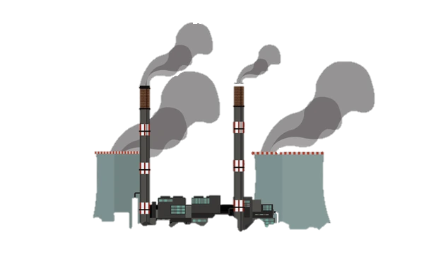
The emission challenge and energy transition
Global greenhouse gas emissions by sector
The world population is consistently growing alongside the worldwide energy demand
Agriculture, Forestry & Land use
18.4%
Waste
3.2%
Industry
5.2%
Development of strategies to promote the decarbonization of the energy system
Heat generation
Electricity generation
Transport
The energy sector mainly relies on the exploitation of fossil fuels
Source: Climate Watch, the World Resources Institute (2020)
Licensed under CC-BY by the author Hannah Ritchie (2020)
Notes:
The main idea behind this work is to contribute to development of solutions capable of promoting the decarbonization of the current energy system. The current energy system in fact mainly relies on the use of fossil fuels with tremendous consequences for our planet and for life on it. Literature indeed reports that the solely energy sector comprising electricity generation, heat generation and transport, is responsible for about 73.2 % of the total emissions. Therefore, in a scenario in which the world population is consistently growing alongside the worldwide energy demand, a transition towards a more sustainable energy scenario becomes essential.

Slide 3


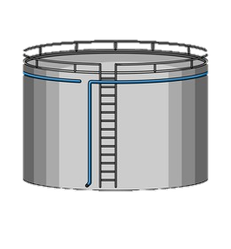

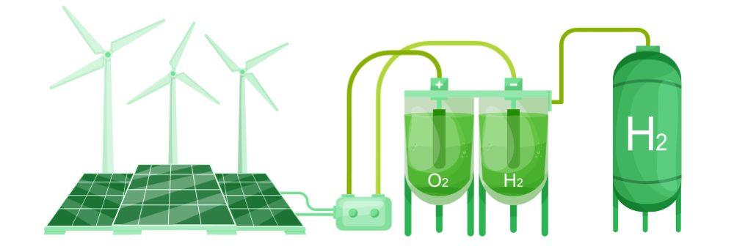
Why ammonia?
Suitable for carbon sensitive applications
PEM fuel cell
RENEWABLE ENERGY
Energy storage in the form of dispatchable energy carriers
NH₃
Existing infrastructure for transport
Existing infrastructure for storage
Carbon free
Intermittency
H₂
Ideal energy carrier
H₂ storage in
liquid carrier compounds
Easy transport over long distances
Easy storage for long time
Possible in-situ decomposition to produce H₂ when required
Carbon free
Low volumetric energy density
Low boiling point
Challenging storage and handling
Notes:
The exploitation of renewable energy sources plays a fundamental role in the energy transition. However, their intermittent nature represents a challenge for coupling the demand with production and poses grid stability challenges. Energy storage can be regarded as the key to overcome this issue and in particular hydrogen has been gaining attention as the ideal energy carrier. Hydrogen could in fact be produced from water electrolysis exploiting renewable energy and used for power generation when required with zero carbon footprint. However, the low volumetric energy density and the low oiling point of hydrogen make its storage and handling challenging.

Slide 4

Ammonia decomposition
Conventional system
H₂ + N₂
NH₃
$$⇄$$
0.5 N₂ + 1.5 H₂
Reaction unit
working at high temperature and low pressure
H₂/N₂ separation unit
H₂
Novel technology
Permeate: H₂
NH₃
Off-gases
Retentate: N₂
MEMBRANE REACTOR
NH₃ decomposition reaction into H₂ and N₂ and high-purity H₂ separation are simultaneously performed
NH₃

Slide 5
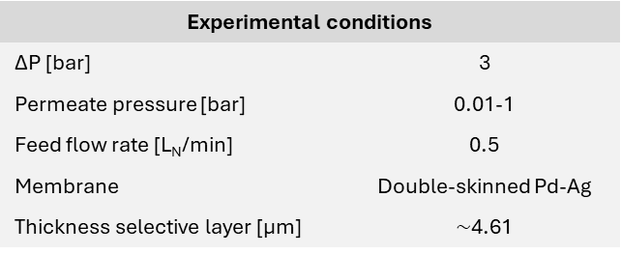
Proof of concept
Permeate: H₂
Retentate: N₂
NH₃
Experimental conditions
ΔP [bar] | 3
Permeate pressure [bar] | 0.01-1
Feed flow rate [L_{N}/min] | 0.5
Membrane | Double-skinned Pd-Ag
Thickness selective layer [μm] | $\sim$4.61
Compared to conventional systems, in a membrane reactor:
Comparable or higher NH₃ conversion can be achieved at lower temperature (higher efficiencies)
High-purity H₂ is recovered
Cechetto, V.; Di Felice, L.; Medrano, J.A.; Makhloufi, C.; Zuniga, J.; Gallucci, F. H₂ production via ammonia decomposition in a catalytic membrane reactor, Fuel Processing Technology, 2021, Volume 216, 106772, https://doi.org/10.1016/j.fuproc.2021.106772.
Notes:
A literature study revealed Pd-based membranes as the most promising ones for high purity hydrogen recovery. Thus, a first proof of concept of the technology was carried out with the aim to assess the advantages implied by the choice of a Pd-based membrane reactor over a conventional system.
The result of this study demonstrated that compared to a conventional system, higher or comparable NH₃ conversion can be achieved in a MR at lower temperature, which results in higher efficiencies. Moreover, it was proven that high purity hydrogen could be simultaneously recovered.
Improved performance could then be achieved by increasing the driving force across the membrane: through the application of vacuum at the permeate side of the membrane in fact higher recoveries as well as NH₃ conversions could be achieved. Interestingly, in this case, NH₃ conversion higher than the thermodynamic equilibrium one without the membrane could be achieved.

Slide 6
Proof of concept
Permeate: H₂
Retentate: N₂
NH₃
Experimental conditions
ΔP [bar] | 3
Permeate pressure [bar] | 0.01-1
Feed flow rate [L_{N}/min] | 0.5
Membrane | Double-skinned Pd-Ag
Thickness selective layer [μm] | $\sim$4.61
Compared to conventional systems, in a membrane reactor:
Higher NH₃ conversion can be achieved at similar pressures (higher compactness)
Lower purities of H₂ recovered
Cechetto, V.; Di Felice, L.; Medrano, J.A.; Makhloufi, C.; Zuniga, J.; Gallucci, F. H₂ production via ammonia decomposition in a catalytic membrane reactor, Fuel Processing Technology, 2021, Volume 216, 106772, https://doi.org/10.1016/j.fuproc.2021.106772.
Notes:
It was also demonstrated that compared to conventional systems, higher ammonia conversion can be achieved in a membrane reactor at similar pressures, which results in higher compactness. Although a pressure increase results in lower purities of hydrogen recovered, the removal of hydrogen from the reaction zone indeed enhances the reaction rates and shifts the reaction thermodynamics which in turn enhance ammonia conversion counterbalancing the ammonia conversion decrease that is on the other hand expected according to the le chateliers principle

Slide 7

The challenge of H₂ purity
PEMFC specifications requires residual NH₃ concentration in the H₂ feed < 0.1 ppm.
Implementation of a cleanup unit downstream of the MR
Economic viability
With no sorbent
With sorbent
T= 450°C, P=3 bar, NH₃ feed flow rate =0.5 L_{N}/min
Thickness selective layer $\sim$1μm
Sorbent: zeolite 13X
The reactor can be operated at lower temperatures with higher residual NH₃ concentration
Higher energy efficiency
Less selective membranes can be implemented
Cechetto, V.; Gutierrez Martinez, R.; Di Felice, L.; Gallucci, F.; Ultra-pure hydrogen production via ammonia decomposition in packed bed membrane reactors, International Journal of Hydrogen Energy, 2022, Volume 47, https://doi.org/10.1016/j.ijhydene.2022.04.240.
Notes:
When targeting the production of hydrogen to be used as fuel for PEMFC, NH3 concentration should not exceed 0.1 ppm. However, the results of the proof of concept proved the achievement of this target challenging. In fact such a low concentration was not achieved in any of the investigated operating conditions. A possible solution to overcome thi challenge is the implementation of a hydrogen cleanup unit downstream of the MR. Both the strategies proved technically feasible. However, strategy 2 proved more economically viable.
Next to the technical feasibility in fact, the use of thinner membranes which already implies lower costs due to the fact that a lower amount of palladium is used for each membrane fabrication, also allows for higher permeation flux through the membrane. This translates into the fact that costs are further lowered as a lower amount of membranes is needed.
Moreover, the fact that the achievement of the purity target is guaranteed by the presence of the cleaning unit allows the reactor to be operated at lower temperatures, which improves the energy efficiency of the system and also implies that less selective membranes can be implemented. This in turn translates in the possibility to use also membrane less performing and cheaper than Pd-based ones.

Slide 8

Research question
Permeate: H₂
Is the membrane reactor-based system economically competitive compared to a conventional system?
Retentate: N₂
?
?
?
Studies available in literature calculated the costs of hydrogen production, but a comparative study addressing a techno-economic assessment at different plant capacities and system configurations is not available.
H₂
Conventional or MR-based system?
NH₃
€
?
This work:
Techno-economic assessment of a decentralized plant for hydrogen production from ammonia decomposition
H₂ for direct use in PEM fuel cells
Applications: stationary applications (a), on-board vehicle applications (b), and refuelling stations (c)
?
?
Target:
500 kg/day of H₂
H₂ purity = 99.97%
Max NH₃ concentration in H₂ stream = 0.1 ppm
NH₃
14
Notes:
Decentralized plant in which hydrogen is produced in a relatively small-scale production system to supply local demand

Slide 9
Design of conventional system for green NH₃-derived hydrogen production
H₂ production: 500 kg/day
Final H₂ application:1) Stationary applications (SA) 2) On-board vehicle applications (O-VA) 3) refueling stations for vehicle applications (R-VA)
Evaluation of operating conditions allowing for minimization of cost of hydrogen (COH)
Evaluated reactor operating conditions: T=450-550°C and P=1-20 bar
Design of the MR-based system
Reactor operating conditions: T_{MR}=T_{CR}-50°C and P_{MR}=P_{CR}
Optimization of the MR-based system design
Investigation of process parameters that optimize COH
Methods

Slide 10



Methods: economic assessment
$$COH= \frac{\left(TOC∙CCF\right)+C_{O\&M,fixed}+C_{O\&M,variable}}{Capacity∙Plant availability}$$
Plant Component | Cost [k€]
Component W | A
Component X | B
Component Y | C
Component Z | D
Bare Erected Cost [BEC] | A+B+C+D
Direct costs as percentage of BEC
Total Installation Costs [TIC] | 80% BEC
Total Direct Plant Cost [TDPC] | BEC+TIC
Indirect Costs [IC] | 14% TDPC
Engineering procurement and construction [EPC] | TDPC+IC
Contingencies and owner’s costs
Contingency | 10% EPC
Owner’s cost | 5% EPC
Total contingencies & OC [C&OC] | 15% EPC
Total Overnight Cost [TOC] | EPC+C&OC
Cost O&M fixed
Maintenance | 2.5% TOC
Insurance | 2% TOC
Labor | 27991 €/year/pp¹
Assumptions
Plant availability | 90%
Plant lifetime (n) | 25 years ³
Catalyst lifetime | 5 years ³
Lifetime Zeolite 13X | 5 years
Membrane lifetime | 5 years
Discount factor (i) | 8% ³
COST O&M variable
Green NH₃ | 853.92 €/ton ²
Electricity | 0.085 €/kWh ³
Catalyst | 143 €/kg ³
Zeolite 13X | 43.7 €/kg ⁴
Membrane | 6000 €/m ³
$$CCF=\frac{{(i+1)}^{n}}{({\left(i+1\right)}^{n}−1)}$$
¹ https://www.payscale.com/research/NL/Job=Chemical_Process_Operator/Salary
² https://www.iea.org/reports/global-hydrogen-review-2021/executive-summary
³ S. Richard, A. Ramirez Santos, and F. Gallucci, “PEM genset using membrane reactors technologies An economic comparison among different e-fuels”, International Journal of Hydrogen Energy
⁴ https://www.msesupplies.com/products/1kg-molecular-sieves-13x-pellets-spheres?variant=31758805205050
$$C_{i}=C_{0}∙{\left(\frac{S_{i}}{S_{0}}\right)}^{n}∙F_{p}∙F_{m}∙F_{T}∙\frac{CEPCI}{{CEPCI}_{reference year}}$$

Slide 11
H₂ production from NH₃: the conventional and the MR-based systems
Conventional system
Membrane reactor-based system
Stationary applications
Stationary applications
Vehicle applications
Vehicle applications
Design choices:
Catalyst: Ru/Al₂O₃
NH₃ removal unit: TSA (2 beds configuration)
N₂ removal unit: PSA (4 beds configuration)
13

Slide 12
Design of the conventional process for SA

Slide 13
Design of the conventional process for VA

Slide 14
Optimization of the conventional system
Stationary applications
(SA)
On-board vehicle applications
(O-VA)
Refueling stations for vehicle applications (R-VA)
COH in the conventional system is minimized with the reactor operated at T=450 °C and 5 bar
The process is OPEX-intensive with the cost of the NH₃ feedstock being the main contributor to COH

Slide 15
Design of the MR-assisted process for SA/VA
The outstanding performance of Pd-based membranes allows to remove the PSA unit

Slide 16
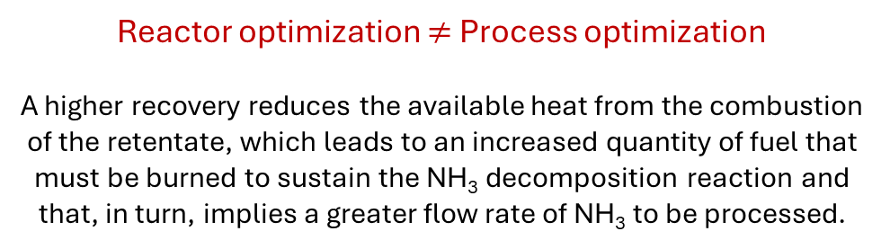
Optimization of MR-based system
H₂
Minimum NH₃ feedstock requirement
NH₃
T_{MR}=T_{CR}-50°C = 400 °C
P_{MR}=P_{CR} = 5 bar
Reactor optimization $≠$ Process optimization
A higher recovery reduces the available heat from the combustion of the retentate, which leads to an increased quantity of fuel that must be burned to sustain the NH₃ decomposition reaction and that, in turn, implies a greater flow rate of NH₃ to be processed.
The cost of NH₃ feedstock is the main contributor to COH
Objective
Minimization of the NH₃ feedstock
Notes:
From a reactor-centric perspective, the greater the hydrogen recovery achieved, the higher is the separation efficiency of hydrogen from ammonia, which results in a lower ammonia flow rate required at the process inlet. However, when considering the whole NH₃-to-H₂ process, the decision to operate the reactor while maximizing hydrogen recovery proves non economically convenient. This is because a higher recovery reduces the available heat from the combustion of the retentate, which leads to an increased quantity of hydrogen that must be burned to sustain the ammonia decomposition reaction and that, in turn, implies a greater flow rate of ammonia to be processed in the reactor.

Slide 17


Technical assessment
Process | Conventional |  |  | MR-assisted
Application | Stationary | Vehicle on-board | Vehicle refueling stations | Stationary and vehicle on-board | Vehicle refueling stations
Feedstock
NH₃ [kg/h] | 151.03 | 153.46 | 153.46 | 146.15 | 146.15
Thermal input [kW_{LHV}] | 780.50 | 793.09 | 793.09 | 755.27 | 755.27
Chemical products
H₂ [kg/h] | 20.83 | 20.83 | 20.83 | 20.83 | 20.83
Thermal output [kW_{LHV}] | 693.92 | 693.92 | 693.92 | 693.92 | 693.92
Cold Gas Efficiency (CGE) | 88.91% | 87.50% | 87.50% | 91.88% | 91.88%
Electricity
Air blower [kW_{el}] | 1.95 | 2.29 | 2.29 | 1.87 | 1.87
Hydrogen booster [kW_{el}] | - | - | 28.33 | 19.33 | 37.09
Hydrogen compressor [kW_{el}] | - | - | 46.04 | - | 45.85
Vacuum pump [kW_{el}] | - | - | - | 29.69 | 29.69
Total electricity [kW_{el}] | 1.95 | 2.29 | 76.74 | 50.89 | 114.50
Overall plant efficiency (η_{tot}) | 88.69% | 87.24% | 79.78% | 86.08% | 79.78%
$$CGE=\frac{{\dot{m}}_{H_{2}}^{ }{LHV}_{H_{2}}}{{\dot{m}}_{{NH}_{3}}^{ }{LHV}_{{NH}_{3}}}$$
$$η_{tot}=\frac{{\dot{m}}_{H_{2}}^{ }{LHV}_{H_{2}}}{{\dot{m}}_{{NH}_{3}}^{ }{LHV}_{{NH}_{3}}+\frac{Q_{el}}{η_{el,ref}}}$$

Slide 18

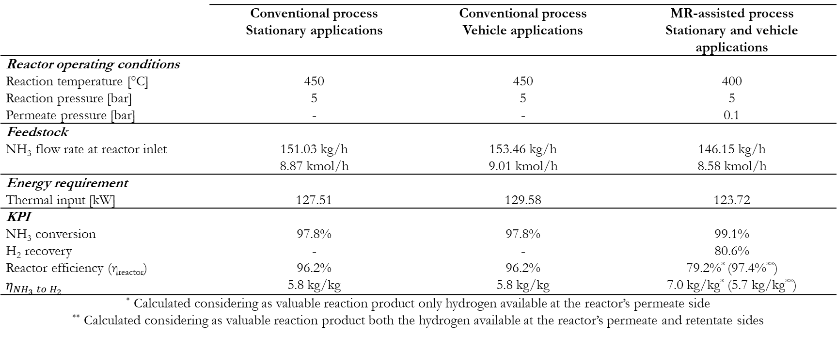
Technical assessment
 | Conventional process Stationary applications | Conventional process Vehicle applications | MR-assisted process Stationary and vehicle applications
Reactor operating conditions
Reaction temperature [°C] | 450 | 450 | 400
Reaction pressure [bar] | 5 | 5 | 5
Permeate pressure [bar] | - | - | 0.1
Feedstock
NH₃ flow rate at reactor inlet | 151.03 kg/h 8.87 kmol/h | 153.46 kg/h 9.01 kmol/h | 146.15 kg/h 8.58 kmol/h
Energy requirement
Thermal input [kW] | 127.51 | 129.58 | 123.72
KPI
NH₃ conversion | 97.8% | 97.8% | 99.1%
H₂ recovery | - | - | 80.6%
Reactor efficiency (η_{reactor}) | 96.2% | 96.2% | 79.2%* (97.4%**)
$η_{{NH}_{3} to H_{2}}$ | 5.8 kg/kg | 5.8 kg/kg | 7.0 kg/kg* (5.7 kg/kg**)
* Calculated considering as valuable reaction product only hydrogen available at the reactor’s permeate side ** Calculated considering as valuable reaction product both the hydrogen available at the reactor’s permeate and retentate sides
$$η_{reactor}=\frac{{\dot{m}}_{H_{2}}^{ }{LHV}_{H_{2}}}{{\dot{m}}_{{NH}_{3}}^{ }{LHV}_{{NH}_{3}}+ W_{in}}$$

Slide 19
Economic assessment
Is the packed bed MR technology competitive compared to the packed bed conventional technology?
Scenario 1: stationary applications
Both in the conventional and in the MR-based systems the COH is 6.95 €/kg
No economic advantage from utilization of the packed bed MR technology
Scenario 2.1: on-board vehicle applications
Conventional system
MR-assisted system
COH = 7.15 €/kg
COH = 6.95 €/kg
CAPEX
CAPEX
OPEX fixed
OPEX fixed
98.36%
NH₃ feedstock
96.64%
NH₃ feedstock
OPEX variable
OPEX variable
Scenario 2.2: refueling stations for vehicle applications
Similar conclusions to scenario 2.1 with COH_{conventional}=7.57 €/kg and COH_{MR-assisted}=7.38 €/kg
Notes:
As a final step, a techno-economic assessment of the MR technology was performed focusing on systems for the decentralized production of H2 from NH3.
3 different scenarios were investigated: the production of hydrogen for stationary applications, the production of hydrogen for on-board vehicle applications and the production of hydrogen for refuelling stations.
The results of the techno-economic assessment demonstrated that in case of hydrogen production for stationary applications, no advantage is given by the utilization of the packed-bed MR technology.
Conversely, the technology was proved to be more economically competitive when targeting the production of hydrogen for vehicle applications.
More in detail, the study revealed the production of hydrogen from ammonia to be an OPEX intensive process, with the cost of NH₃ feedstock being the main contributor to the final COH.
Thus, the lower COH in the MR-assisted system can be mainly ascribed to the fact that in this configuration a lower ammonia feedstock is required.

Slide 20
Economic assessment
Sensitivity analysis and forecasting
Year | Cost of NH₃ [€/ton] | COH [€/kg]
2020 | 853.92 | 6.95
2030 | 377.07 | 3.60
2050 | 277.30 | 2.90
https://www.iea.org/reports/global-hydrogen-review-2021/executive-summary

Slide 21

Conclusions
Permeate: H₂
In a membrane reactor for H₂ production from NH₃:
Higher efficiency and compactness compared to a conventional system are achieved
Optimization is possible by tuning the membrane separation performance, the membrane area and the operating conditions
Fuel cell-grade H₂ production is possible with the addition of a relatively inexpensive sorption unit downstream of the reactor.
Retentate: N₂
From an economic point of view, the recovery of H₂ from green NH₃ using MRs can be achieved at lower costs compared to the benchmark technology.
NH₃
The MR technology holds significant potential in advancing the decarbonization of the current energy system.
Notes:
In this last slide I would therefore like to summarize the main outcomes of my work.
All in all, this findings can lead to the conclusion that the MR technology holds potential in advancing the decarbonization of the current energy system.

Slide 22
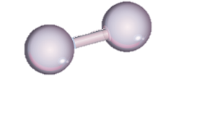
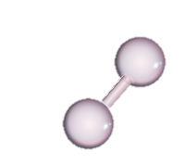
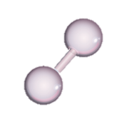
Thank you for your attention

