Slide 1
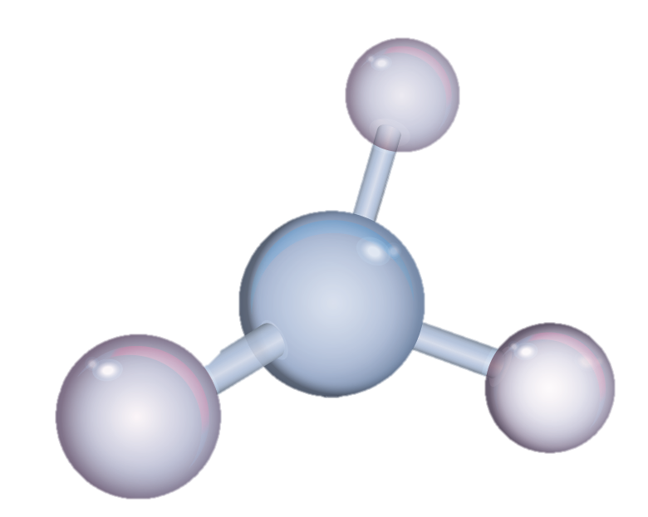
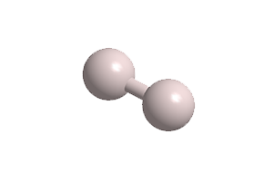
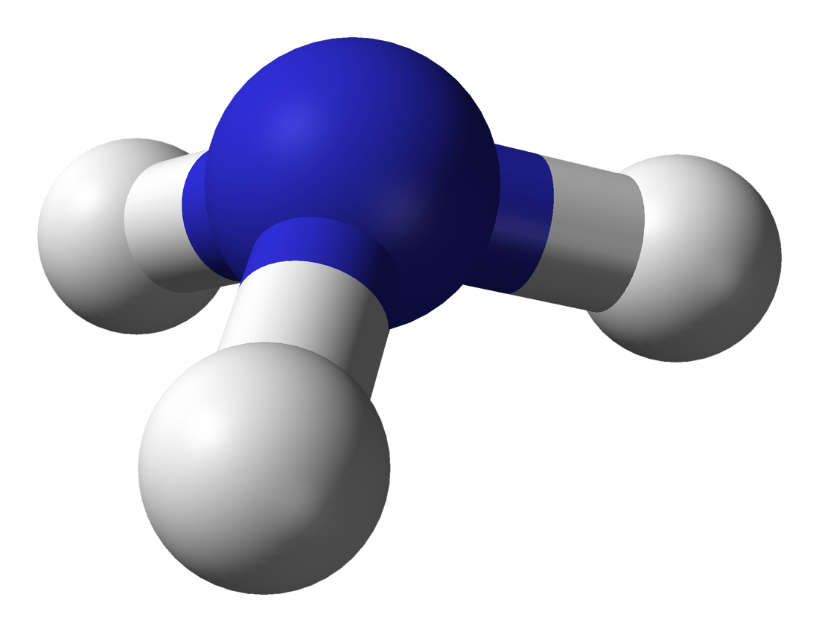
IX Symposium on Hydrogen, Fuel Cells and Advanced Batteries
Milazzo, 3rd July 2024
Hydrogen production from ammonia in carbon molecular sieve membrane reactors
H₂
Dr. Valentina Cechetto
MSc. Gaetano Anello
Dr. Arash Rahimalimamaghani
Prof. Dr. Eng. Fausto Gallucci
NH₃

Slide 2
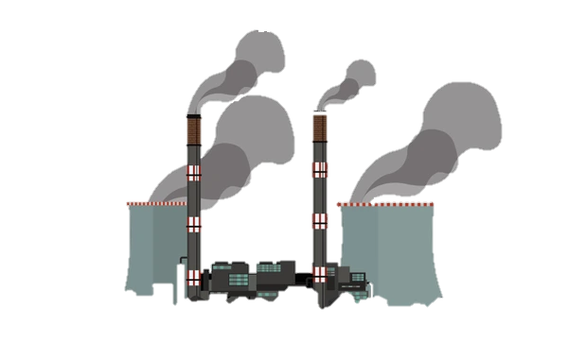
The emission challenge and energy transition
Global greenhouse gas emissions by sector
The world population is consistently growing alongside the worldwide energy demand
Agriculture, Forestry & Land use
18.4%
Waste
3.2%
Industry
5.2%
Development of strategies to promote the decarbonization of the energy system
Heat generation
Electricity generation
Transport
The energy sector mainly relies on the exploitation of fossil fuels
Source: Climate Watch, the World Resources Institute (2020)
Licensed under CC-BY by the author Hannah Ritchie (2020)
Notes:
The main idea behind this work is to contribute to development of solutions capable of promoting the decarbonization of the current energy system. The current energy system in fact mainly relies on the use of fossil fuels with tremendous consequences for our planet and for life on it. Literature indeed reports that the solely energy sector comprising electricity generation, heat generation and transport, is responsible for about 73.2 % of the total emissions. Therefore, in a scenario in which the world population is consistently growing alongside the worldwide energy demand, a transition towards a more sustainable energy scenario becomes essential.

Slide 3
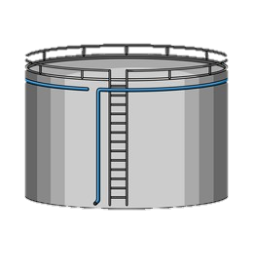
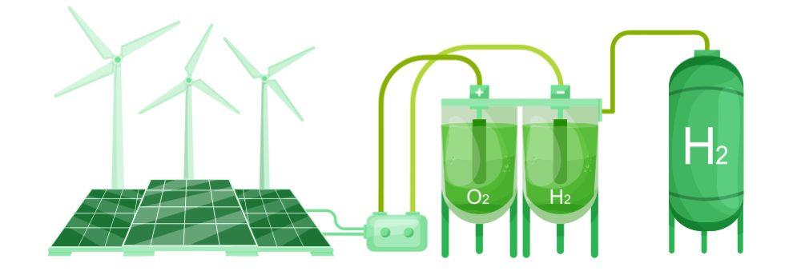
Why ammonia?
Suitable for carbon sensitive applications
PEM fuel cell
RENEWABLE ENERGY
Energy storage in the form of dispatchable energy carriers
NH₃
Existing infrastructure for transport
Existing infrastructure for storage
Carbon free
Intermittency
H₂
Ideal energy carrier
H₂ storage in
liquid carrier compounds
Easy transport over long distances
Easy storage for long time
Possible in-situ decomposition to produce H₂ when required
Carbon free
Low volumetric energy density
Low boiling point
Challenging storage and handling
Notes:
The exploitation of renewable energy sources plays a fundamental role in the energy transition. However, their intermittent nature represents a challenge for coupling the demand with production and poses grid stability challenges. Energy storage can be regarded as the key to overcome this issue and in particular hydrogen has been gaining attention as the ideal energy carrier. Hydrogen could in fact be produced from water electrolysis exploiting renewable energy and used for power generation when required with zero carbon footprint. However, the low volumetric energy density and the low oiling point of hydrogen make its storage and handling challenging.

Slide 4
Ammonia decomposition
Conventional system
H₂ + N₂
NH₃
$$⇄$$
0.5 N₂ + 1.5 H₂
Reaction unit
working at high temperature and low pressure
H₂/N₂ separation unit
H₂
Novel technology
Permeate: H₂
NH₃
Off-gases
Retentate: N₂
MEMBRANE REACTOR
NH₃ decomposition reaction into H₂ and N₂ and high-purity H₂ separation are simultaneously performed
NH₃

Slide 5
Proof of concept
Permeate: H₂
Retentate: N₂
NH₃
Experimental conditions
ΔP [bar] | 3
Permeate pressure [bar] | 0.01-1
Feed flow rate [L_{N}/min] | 0.5
Membrane | Double-skinned Pd-Ag
Thickness selective layer [μm] | $\sim$4.61
Compared to conventional systems, in a membrane reactor:
Comparable or higher NH₃ conversion can be achieved at lower temperature (higher efficiencies)
High-purity H₂ is recovered
Cechetto, V.; Di Felice, L.; Medrano, J.A.; Makhloufi, C.; Zuniga, J.; Gallucci, F. H₂ production via ammonia decomposition in a catalytic membrane reactor, Fuel Processing Technology, 2021, Volume 216, 106772, https://doi.org/10.1016/j.fuproc.2021.106772.
Notes:
A literature study revealed Pd-based membranes as the most promising ones for high purity hydrogen recovery. Thus, a first proof of concept of the technology was carried out with the aim to assess the advantages implied by the choice of a Pd-based membrane reactor over a conventional system.
The result of this study demonstrated that compared to a conventional system, higher or comparable NH₃ conversion can be achieved in a MR at lower temperature, which results in higher efficiencies. Moreover, it was proven that high purity hydrogen could be simultaneously recovered.
Improved performance could then be achieved by increasing the driving force across the membrane: through the application of vacuum at the permeate side of the membrane in fact higher recoveries as well as NH₃ conversions could be achieved. Interestingly, in this case, NH₃ conversion higher than the thermodynamic equilibrium one without the membrane could be achieved.

Slide 6
Proof of concept
Permeate: H₂
Retentate: N₂
NH₃
Experimental conditions
ΔP [bar] | 3
Permeate pressure [bar] | 0.01-1
Feed flow rate [L_{N}/min] | 0.5
Membrane | Double-skinned Pd-Ag
Thickness selective layer [μm] | $\sim$4.61
Compared to conventional systems, in a membrane reactor:
Higher NH₃ conversion can be achieved at similar pressures (higher compactness)
Lower purities of H₂ recovered
Cechetto, V.; Di Felice, L.; Medrano, J.A.; Makhloufi, C.; Zuniga, J.; Gallucci, F. H₂ production via ammonia decomposition in a catalytic membrane reactor, Fuel Processing Technology, 2021, Volume 216, 106772, https://doi.org/10.1016/j.fuproc.2021.106772.
Notes:
It was also demonstrated that compared to conventional systems, higher ammonia conversion can be achieved in a membrane reactor at similar pressures, which results in higher compactness. Although a pressure increase results in lower purities of hydrogen recovered, the removal of hydrogen from the reaction zone indeed enhances the reaction rates and shifts the reaction thermodynamics which in turn enhance ammonia conversion counterbalancing the ammonia conversion decrease that is on the other hand expected according to the le chateliers principle

Slide 7
The challenge of H₂ purity
PEMFC specifications requires residual NH₃ concentration in the H₂ feed < 0.1 ppm.
Implementation of a cleanup unit downstream of the MR
Economic viability
With no sorbent
With sorbent
T= 450°C, P=3 bar, NH₃ feed flow rate =0.5 L_{N}/min
Thickness selective layer $\sim$1μm
Sorbent: zeolite 13X
The reactor can be operated at lower temperatures with higher residual NH₃ concentration
Higher energy efficiency
Less selective membranes can be implemented
Cechetto, V.; Gutierrez Martinez, R.; Di Felice, L.; Gallucci, F.; Ultra-pure hydrogen production via ammonia decomposition in packed bed membrane reactors, International Journal of Hydrogen Energy, 2022, Volume 47, https://doi.org/10.1016/j.ijhydene.2022.04.240.
Notes:
When targeting the production of hydrogen to be used as fuel for PEMFC, NH3 concentration should not exceed 0.1 ppm. However, the results of the proof of concept proved the achievement of this target challenging. In fact such a low concentration was not achieved in any of the investigated operating conditions. A possible solution to overcome thi challenge is the implementation of a hydrogen cleanup unit downstream of the MR. Both the strategies proved technically feasible. However, strategy 2 proved more economically viable.
Next to the technical feasibility in fact, the use of thinner membranes which already implies lower costs due to the fact that a lower amount of palladium is used for each membrane fabrication, also allows for higher permeation flux through the membrane. This translates into the fact that costs are further lowered as a lower amount of membranes is needed.
Moreover, the fact that the achievement of the purity target is guaranteed by the presence of the cleaning unit allows the reactor to be operated at lower temperatures, which improves the energy efficiency of the system and also implies that less selective membranes can be implemented. This in turn translates in the possibility to use also membrane less performing and cheaper than Pd-based ones.

Slide 8
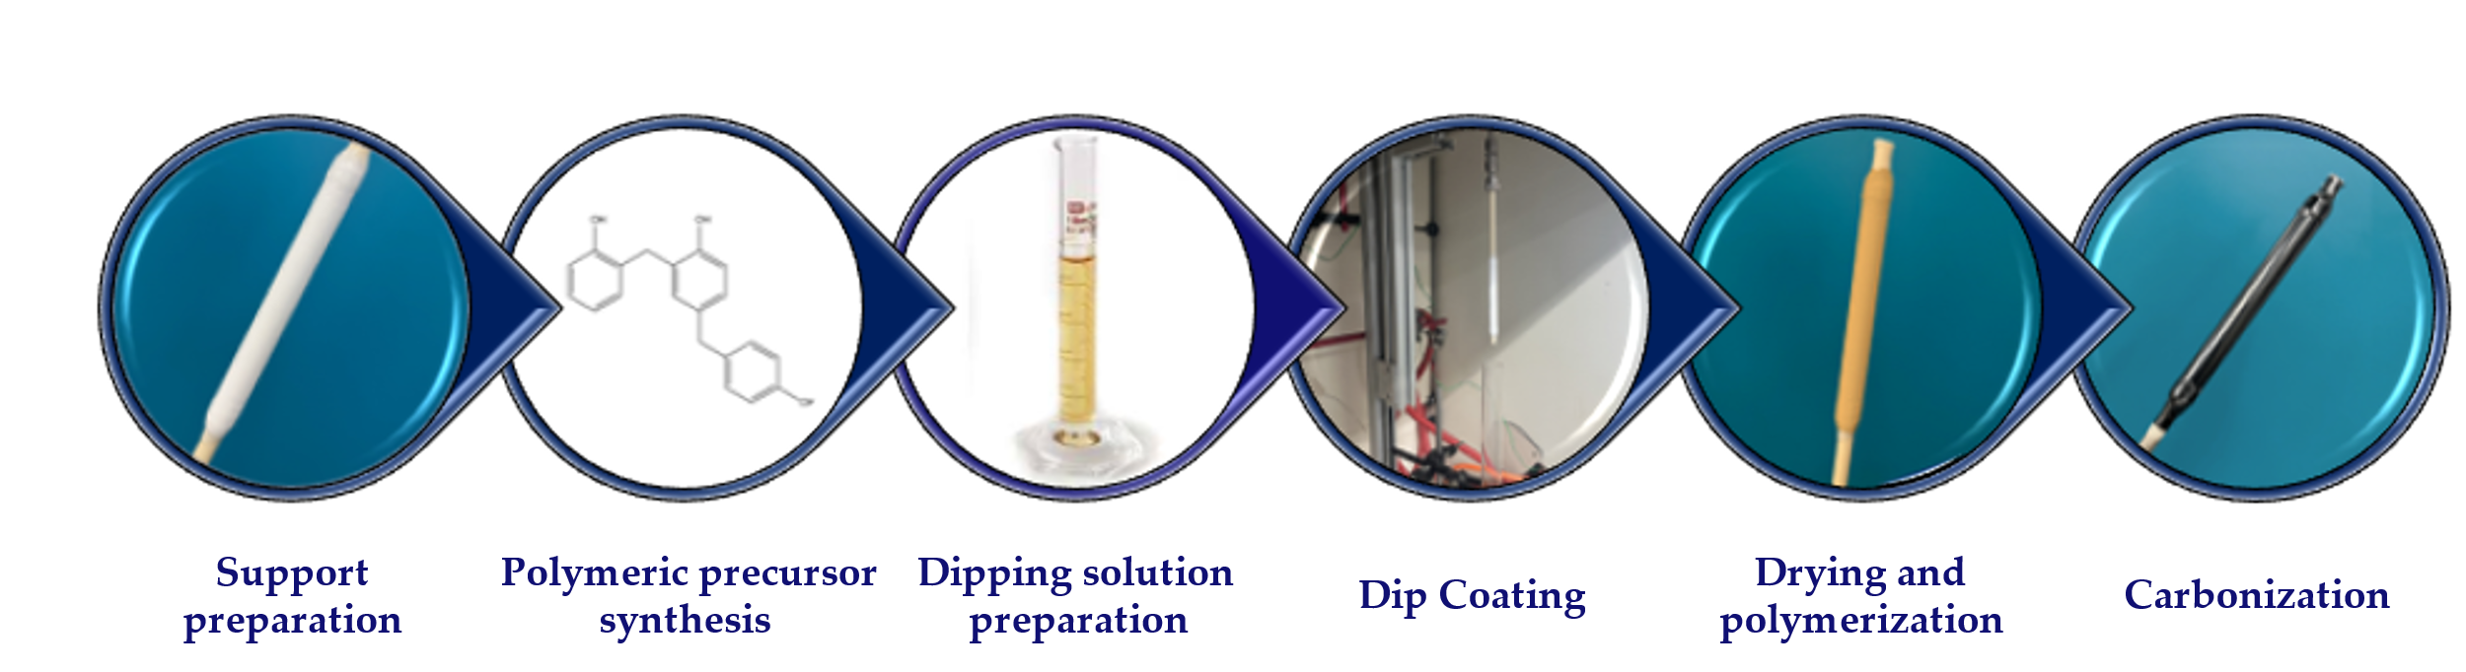
Carbon molecular sieve membranes for H₂ recovery from NH₃
Membrane preparation
Permeation temperature
Molecular sieving and/or adsorption diffusion are the main transport mechanisms
H₂-selective membrane
Cechetto, V.; Anello, G.; Rahimalimamaghani, A.; Gallucci, F. Carbon Molecular Sieve Membrane Reactors for Ammonia Cracking. Processes 2024, 12, 1168. https://doi.org/10.3390/pr12061168
Notes:
the increase of hydrogen permeance with temperature indicates the dominance of activated transport mechanisms such as molecular sieving and surface diffusion.
The negative slope of hydrogen permeation as a function of pressure indicates then the negligible contribution of viscous flow through the membrane and therefore the absence of defects on the membrane’s surface
). Hydrogen is the gas showing the highest permeance and this can be explained analyzing the pore size distribution of the membrane. Here it is in fact shown that most of the pores are bigger than the kinetic diameter of hydrogen (0.289 nm), indicating that hydrogen permeation through the membrane is promoted. Nitrogen permeation through the membrane is on the other hand less favored since only about 26% of the pores show a bigger size compared to its kinetic diameter.
As far as ammonia concerns, despite its lower kinetic diameter compared to the one of hydrogen, it shows a lower permeance compared to the one hydrogen. The main reason for this lies in the contribution of molecular sieving to the permeation mechanism. Ammonia permeation can in fact only take place through those pores which have a larger size compared to its kinetic diameter (0.260 nm) and is therefore inhibited through about 24% of the pores. Moreover, a similar behavior of permeation compared to hydrogen has been observed in literature for helium (He), which has indeed the same kinetic diameter of ammonia. As this behavior has been ascribed to higher adsorption affinity of hydrogen in carbon membranes compared to helium as well as to the smaller cross section diameter of hydrogen which results in lower resistance to gas transport through the pores by molecular sieving mechanism [48], the same explanation might justify the trend of ammonia permeation compared to the one of hydrogen experienced in this work.

Slide 9
Carbon molecular sieve membranes for H₂ recovery from NH₃
Thermodynamic equilibrium conversion
Permeate: H₂
Retentate: N₂
NH₃
Experimental conditions
ΔP [bar] | 5
Permeate pressure [bar] | 1
Feed flow rate [L_{N}/min] | 0.5
Membrane | CMSM
PEMFC grade H₂ was not achieved at the reactor’s outlet
NH₃ concentration in the permeate <0.75 ppm was achieved through the implementation of a sorption unit downstream of the reactor.
Cechetto, V.; Anello, G.; Rahimalimamaghani, A.; Gallucci, F. Carbon Molecular Sieve Membrane Reactors for Ammonia Cracking. Processes 2024, 12, 1168. https://doi.org/10.3390/pr12061168

Slide 10
Conclusions
Permeate: H₂
In a membrane reactor for H₂ production from NH₃:
Higher efficiency and compactness compared to a conventional system are achieved
Fuel cell-grade H₂ production is possible with the addition of a relatively inexpensive sorption unit downstream of the reactor.
Carbon membranes can be regarded a competitive alternative to Pd-based membranes
Retentate: N₂
NH₃
The MR technology holds significant potential in advancing the decarbonization of the current energy system.
Notes:
In this last slide I would therefore like to summarize the main outcomes of my work.
All in all, this findings can lead to the conclusion that the MR technology holds potential in advancing the decarbonization of the current energy system.

Slide 11
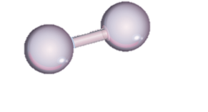
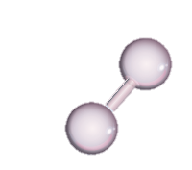
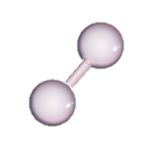
Thank you for your attention

